Slide 1
Matlab NN Toolbox
  http://www.mathworks.com/

Slide 2
Implementation
1. Loading data source.
2. Selecting attributes required.
3. Decide training, validation, and testing data.
4. Data manipulations and Target generation.
  (for supervised learning)
5. Neural Network creation (selection of network architecture) and initialisation.
6. Network Training and Testing.
7. Performance evaluation.

Slide 3
Loading and Saving data
load: retrieve data from disk.
  In ascii or .mat format.
>> data = load(‘nndata.txt’);
>> whos data;
Name Size Bytes Class
data 826x7 46256 double array
Save: saves variables in matlab environment in .mat format.
>> save nnoutput.txt x, y ,z;

Slide 4
Matrix manipulation
region = data(:,1);
training = data([1:500],:)
w=[1;2]; w*w’ => [1,2;2,4];
w=[1,2;2,4]; w.*w => [1,4;4,16];
1 2
2 4
1 4
4 16

Slide 5
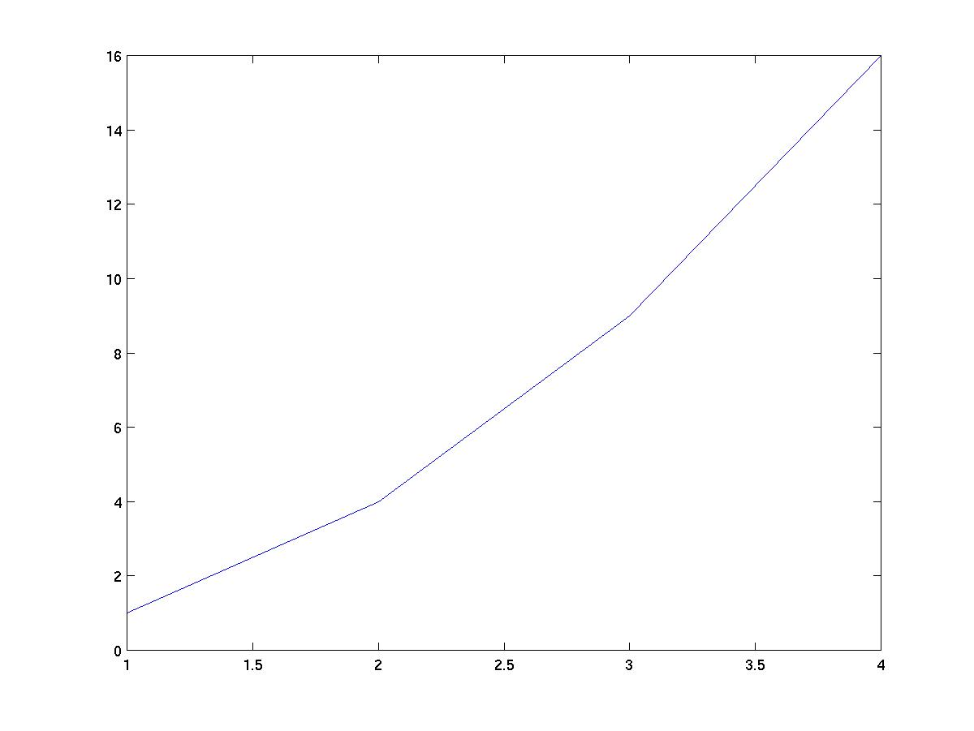
Plotting Data
plot : plot the vector in 2D or 3D
  >> y = [1 2 3 4]; figure(1); plot(power(y,2));
Redefine x axis:
>> x = [2 4 6 8];
>> plot(x,power(y,2));

Slide 6
Network creation
>>net = newff(PR,[S1 S2...SNl],{TF1 TF2...TFNl},BTF,BLF,PF)
PR - Rx2 matrix of min and max values for R input elements.
Si - Size of ith layer, for Nl layers.
TFi - Transfer function of ith layer, default = 'tansig'.
BTF - Backprop network training function,
  default = 'trainlm'.
BLF - Backprop weight/bias learning function,
  default = 'learngdm'.
PF - Performance function,
  default = 'mse’
newff : create and returns “net” = a feed-forward backpropagation network.

Slide 7
Network creation (cont.)
S2: number of ouput neuron
S1: number hidden neurons
Number of inputs decided by PR

Slide 8
Network Initialisation
-1 1
-1 1
-1 1
-1 1
neuron 1
>> PR = [-1 1; -1 1; -1 1; -1 1];
Min
Max
Initialise the net’s weighting and biases
>> net = init(net); % init is called after newff
re-initialise with other function:
  net.layers{1}.initFcn = 'initwb';
  net.inputWeights{1,1}.initFcn = 'rands';
  net.biases{1,1}.initFcn = 'rands';
  net.biases{2,1}.initFcn = 'rands';

Slide 9
Neurons activation
>> net = newff([-1 1; -1 1; -1 1; -1 1], [4,1], {‘logsig’ ‘logsig’});
TF2: logsig
TF1: logsig

Slide 10
Network Training
The overall architecture of your neural network is store in the variable net;
variable can be reset.
net.trainParam.epochs =1000; (Max no. of epochs to train) [100]
net.trainParam.goal =0.01; (stop training if the error goal hit) [0]
net.trainParam.lr =0.001; (learning rate, not default trainlm) [0.01]
net.trainParam.show =1; (no. epochs between showing error) [25]
net.trainParam.time =1000; (Max time to train in sec) [inf]

Slide 11
net.trainParam parameters:
epochs: 100
goal: 0
max_fail: 5
mem_reduc: 1
min_grad: 1.0000e-010
mu: 0.0010
mu_dec: 0.1000
mu_inc: 10
mu_max: 1.0000e+010
show: 25
time: Inf

Slide 12
net.trainFcn options
net.trainFcn=trainlm ; a variant of BP based on second order algorithm (Levenberg-Marquardt)

Slide 13
Network Training(cont.)
TRAIN trains a network NET according to NET.trainFcn and NET.trainParam.
>> TRAIN(NET,P,T,Pi,Ai)
NET - Network.
P - Network inputs.
T - Network targets, default = zeros.
Pi - Initial input delay conditions, default = zeros.
Ai - Initial layer delay conditions, default = zeros.
>> p = [-0.5 1 -0.5 1; -1 0.5 -1 0.5; 0.5 1 0.5 1; -0.5 -1 -0.5 -1];
-0.5 1 -0.5 1
-1 0.5 -1 0.5
0.5 1 0.5 1
-0.5 -1 -0.5 -1
For neuron 1
Training pattern 1

Slide 14
Network Training(cont.)
>>TRAIN(NET,P,T,Pi,Ai) NET - Network.
P - Network inputs.
T - Network targets, default = zeros. (optional only for NN with targets)
Pi - Initial input delay conditions, default = zeros.
Ai - Initial layer delay conditions, default = zeros.
>> p = [-0.5 1 -0.5 1; -1 0.5 -1 0.5; 0.5 1 0.5 1; -0.5 -1 -0.5 -1];
>> t = [-1 1 -1 1];
>> net = train(net, p, t);
-1 1 -1 1
Training pattern 1

Slide 15
Simulation of the network
>> [Y] = SIM(model, UT)
Y : Returned output in matrix or structure format.
model : Name of a block diagram model.
UT : For table inputs, the input to the model is interpolated.
>> UT = [-0.5 1 ; -0.25 1; -1 0.25 ; -1 0.5];
>> Y = sim(net,UT);
-0.5 1.00
-0.25 1.00
-1.00 0.25
-1.00 0.50
For neuron 1
Training pattern 1

Slide 16
Performance Evaluation
Comparison between target and network’s output in testing set.
Comparison between target and network’s output in training set.
Design a metric to measure the distance/similarity of the target and output, or simply use mse.

Slide 17
NEWSOM
Create a self-organizing map.
>> net = newsom(PR,[d1,d2,...],tfcn,dfcn,olr,osteps,tlr,tns)
PR - Rx2 matrix of min and max values for R input elements.
Di - Size of ith layer dimension, defaults = [5 8].
TFCN - Topology function, default = 'hextop'.
DFCN - Distance function, default = 'linkdist'.
OLR - Ordering phase learning rate, default = 0.9.
OSTEPS - Ordering phase steps, default = 1000.
TLR - Tuning phase learning rate, default = 0.02;
TND - Tuning phase neighborhood distance, default = 1.

Slide 18
NewSom parameters
The topology function TFCN can be HEXTOP, GRIDTOP, or RANDTOP.
The distance function can be LINKDIST, DIST, or MANDIST.
Exmple:
>> P = [rand(1,400)*2; rand(1,400)];
>> net = newsom([0 2; 0 1],[3 5]);
>> plotsom(net.layers{1}.positions)
TRAINWB1 By-weight-&-bias 1-vector-at-a-time training function
>> [net,tr] = trainwb1(net,Pd,Tl,Ai,Q,TS,VV,TV)

